Slide 1


CS M148
UCLA
2024
Diagnosing Alzheimer’s With Machine Learning
CS M148
Engineered by Aneesh Bonthala, Arash Dewan, Jason Wan, William Escobar, Zeeshan Zaidi

Slide 2




CS M148
UCLA
2024
Table Of Contents
Data Cleaning
Preprocessing our preparing our data.
Modeling
Optimizing and testing algorithms.
Evaluation
Comparing and visualizing results.
Conclusion
Drawing and interpreting our findings.

Slide 3

CS M148
UCLA
2024
Problem
Vision
Alzheimer’s: A Progressive Neurodegenerative Disorder
The significant challenge of diagnosing Alzheimer’s is the rapid onset and progression that can occur, alongside the mistaken symptoms that are ignored.
Methods today consist of cognitive tests, brain imaging, biomarkers, and invasive procedures in order to determine whether a patient has this disorder or not.
Most learn when it is too late, and with the delayed administration of treatments, we are always
a step behind the quality
The Critical Need for Non-invasive Predictive Methods of Diagnoses
This disease affects millions of individuals, and it motivates us to leverage the techniques of modeling and classification in order to create algorithms that can aid in the process.
By gathering advanced data analytics, clinical features, and medical tools, we can pool a dataset that can maybe facilitate in early detection.
This project envisions a future where early diagnosis is accessible to all, and help the medical
world better understand this disease.

Slide 4

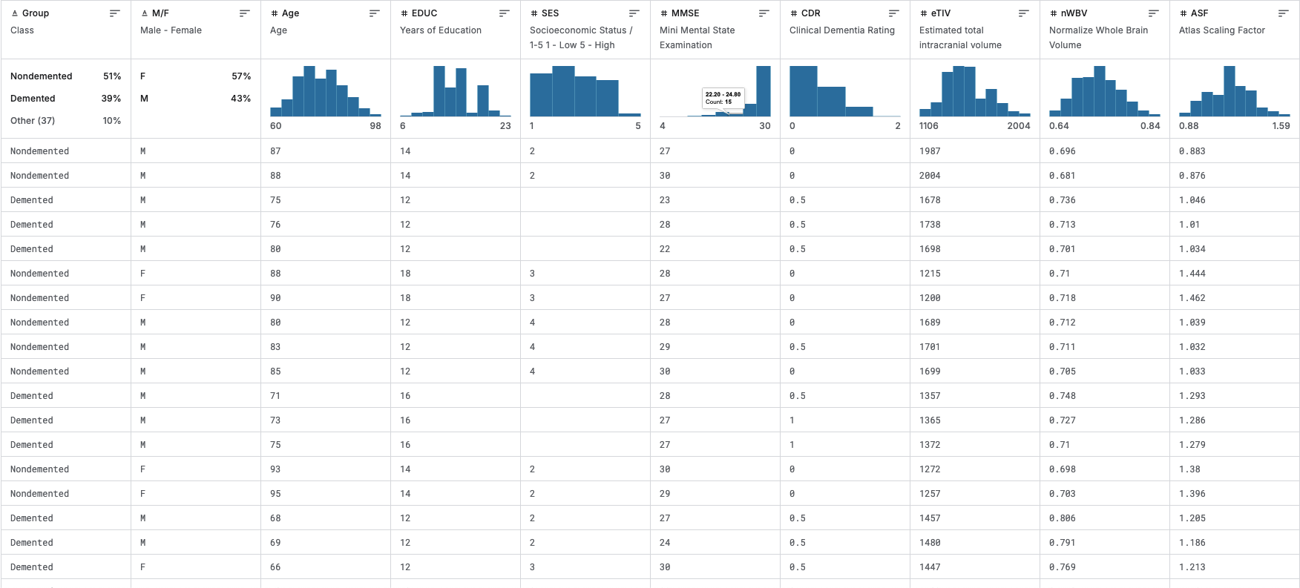
CS M148
UCLA
2024
Our Dataset
Features
Age
Gender
Years of Education
Socioeconomic Status
Mini Mental State Exam
Clinical Dementia Rating
Total intracranial volume
Whole Brain Volume
Atlas Scaling Factor
Target
Our Target is the ‘Group’ column which labels participants of the study as ‘Demented’ (exhibiting signs of Alzheimer's), Converted (developing Alzheimer's) and ‘Non-Demented’

Slide 5

CS M148
UCLA
2024
Data Cleaning

Slide 6

CS M148
UCLA
2024
Replacement
Normalization
2 MMSE values
mean of 25 nearest neighbors
19 SES values
mean of all available values
Brain Volume measures are large, continuous integers so we applied min-max normalization s
Feature Engineering
We assigned sex (Male or Female) and disease state (Demented/Converted or Non-Demeneted) to binary outcomes 1 and 0
Data Cleaning

Slide 7
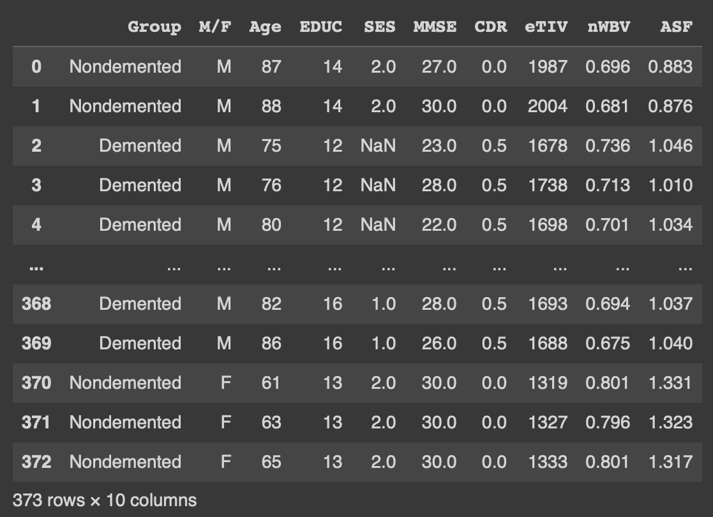
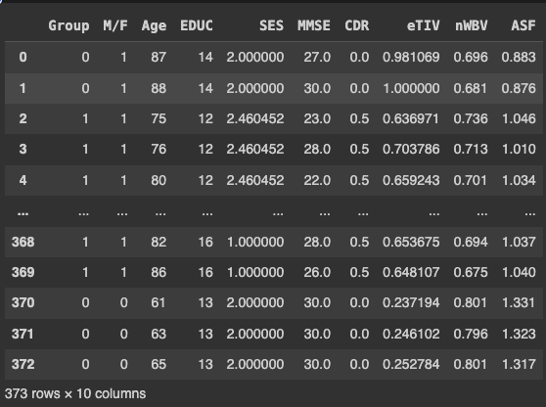
CS M148
UCLA
2024
Data Cleaning

Slide 8

CS M148
UCLA
2024
Modeling

Slide 9
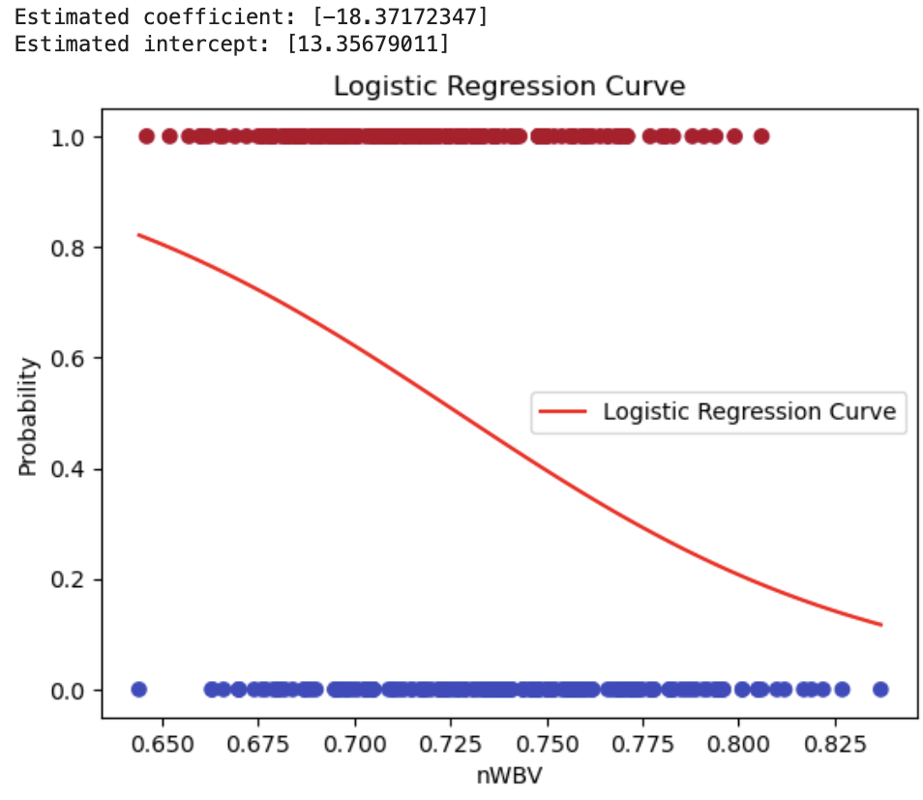
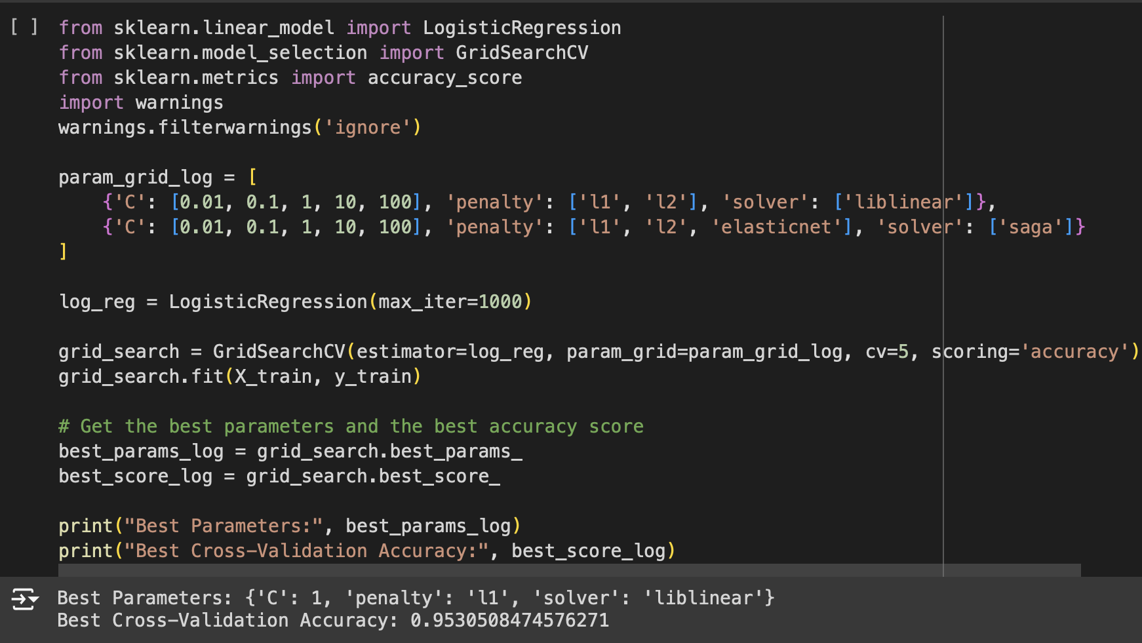
CS M148
UCLA
2024
Logistic Regression
Left Image (Logistic Regression Curve w/ nWBV feature)
Description
Image Below (Cross Validating Logistic Regression)
-Most optimal parameters included C value of 1, L1 Regularization, and liblinear solver to get best accuracy
Results
- Best Cross-Validation Accuracy: 0.95305
- On unseen data, Test Accuracy: 0.92

Slide 10
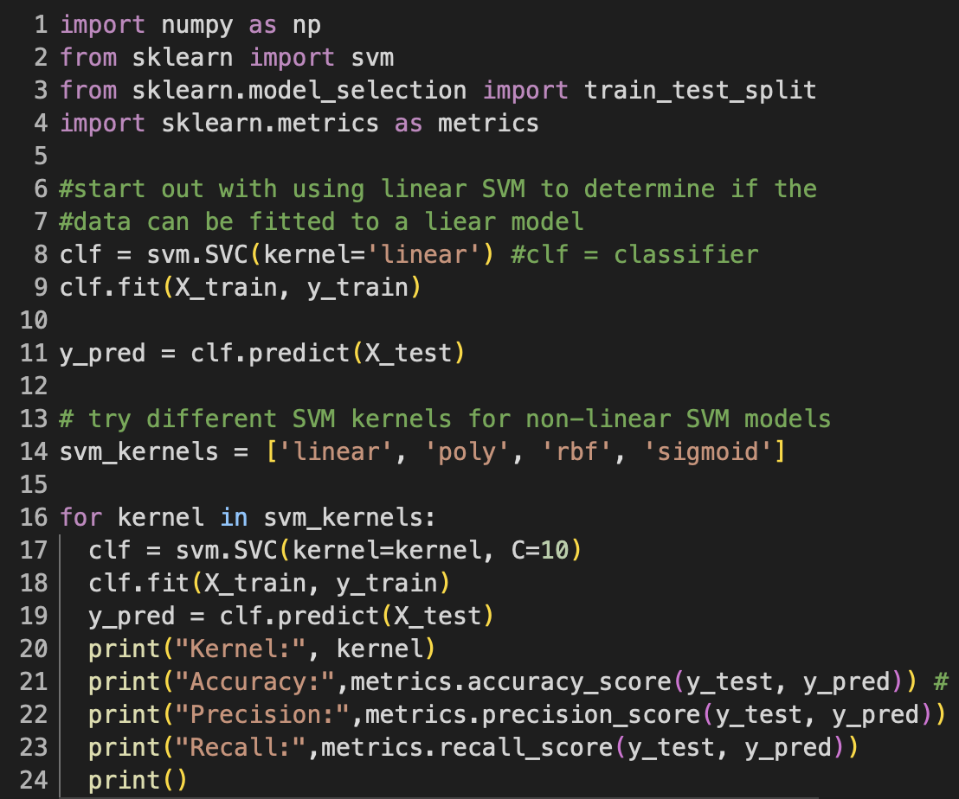
CS M148
UCLA
2024
Linear & Non-Linear SVM
Description
Trained our data using Linear and Non-linear SVMs. Tested different kernels to determine which model would be best suited for classification.
Kernel | Accuracy | Precision | Recall
Linear | 0.92 | 1.0 | 0.8125
Polynomial (poly) | 0.76 | 0.79 | 0.59
Gaussian (rbf) | 0.79 | 0.86 | 0.59
Sigmoid | 0.35 | 0.29 | 0.375
Results
Linear SVM proved to perform better than all other kernels having the same level of accuracy as the linear regression model

Slide 11
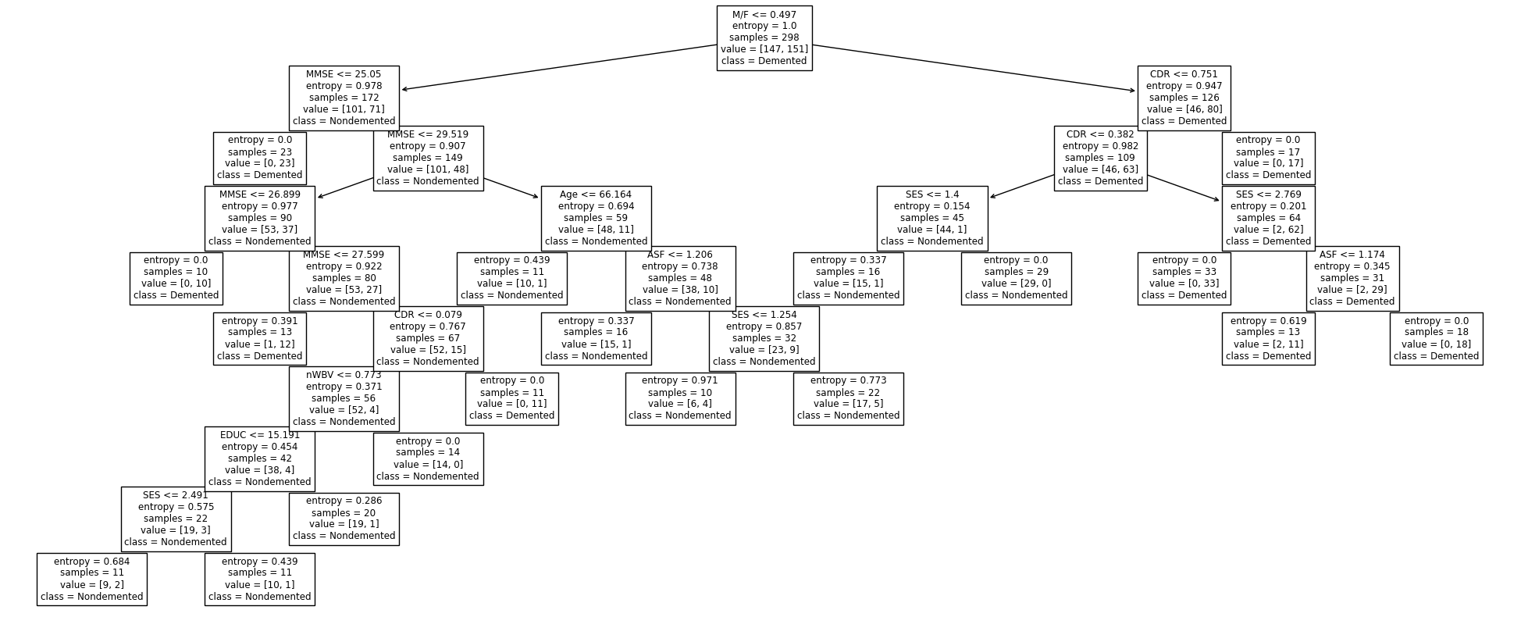
CS M148
UCLA
2024
Description
Results
Decision
Tree
Notable optimal hyperparameters:
Using entropy as the splitting metric
Setting a max depth of 10 layers
Cross validation accuracy of 96%
Test set accuracy of 93%

Slide 12
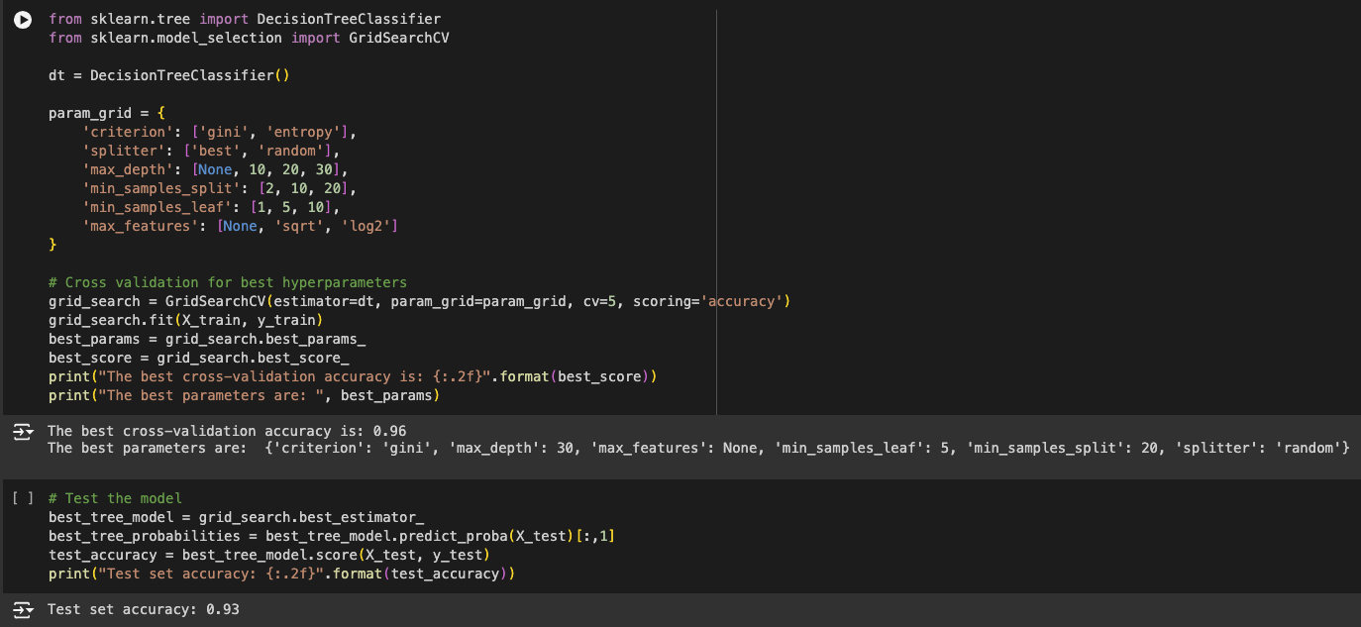
CS M148
UCLA
2024
Random
Forest
Description
-Ran 300 iterations of varied parameters to find best Forest
-Model uses Gini impurity calculations, random splitting, and a max depth of 30
Code
Results
Cross-Validation Accuracy = 0.96
Test Accuracy = 0.93
ROC AUC = 0.95

Slide 13
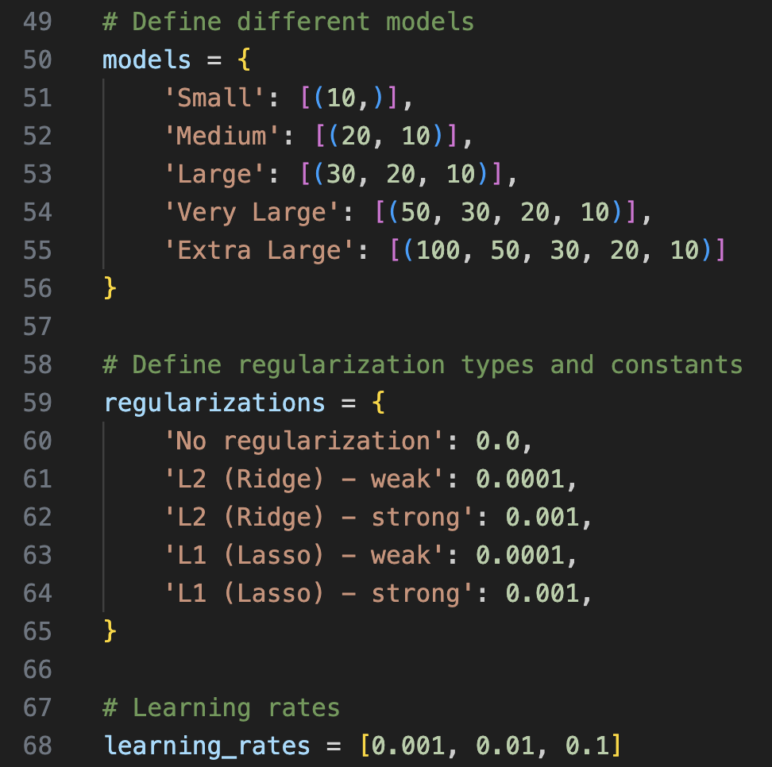
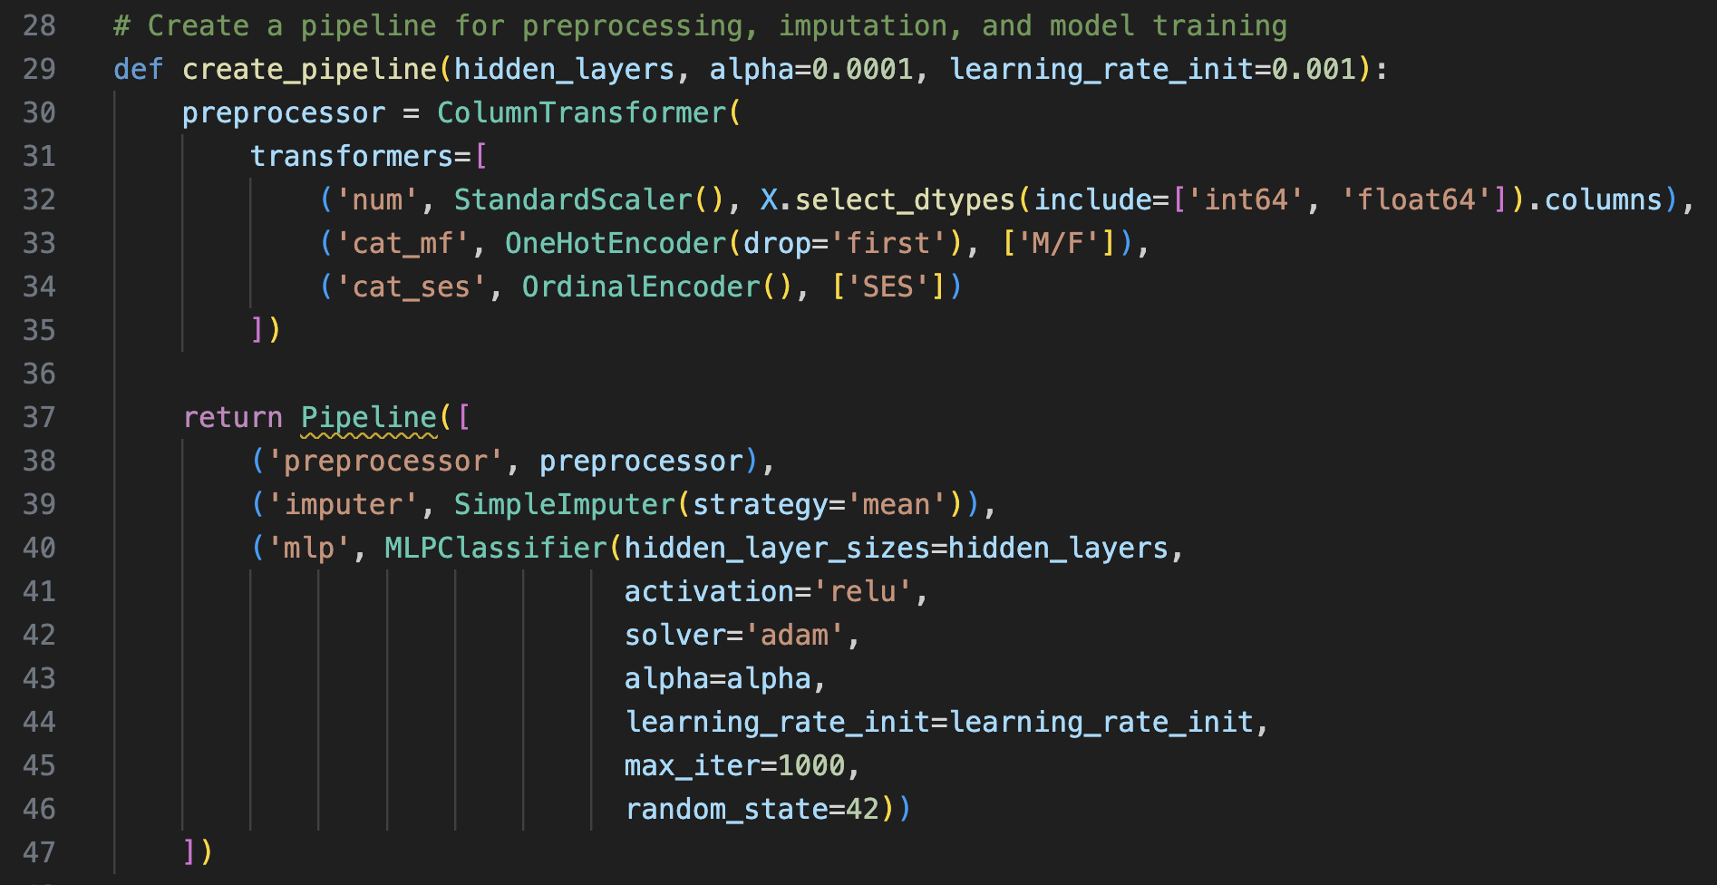
CS M148
UCLA
2024
Neural
Networks
Description
Tested 75 different models
Based on: Size, Regularizations, and Learning Rates
Sklearn’s MLPClassifier
ReLU for Hidden Layers
Sigmoid Function for Output Layer
Defining model and different combinations
Results
Best Model:
Very Large
No Regularization
0.1 learning rate
(via CV, 94.97% Training, 90.67% Test)

Slide 14
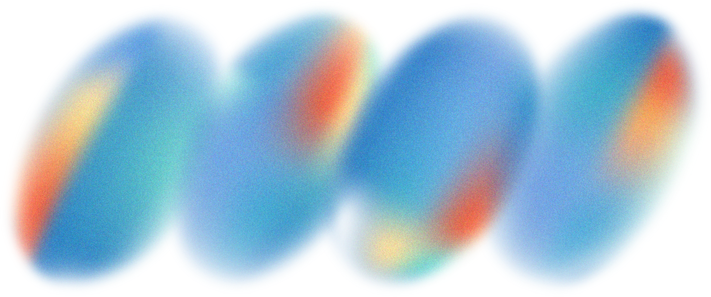
CS M148
UCLA
2024
Evaluation

Slide 15

CS M148
UCLA
2024
Logistic Regression
SVMs
The Logistic Regression model worked excellent on all accounts through cross validation and plotting
However, because the sigmoid function is the core of logistic regression, we have to assume linearity between a binary set of data
With the amount of features and possibilities, logistic regression may not be the best visualizer
SVM models showed a strong linear relationship between diagnosis and the 8 features we considered
Insists that the dataset contains features which are linearly related, such as the following 6
Age
MMSE
CDR
eTIV
nWBV
ASF

Slide 16
CS M148
UCLA
2024
Decision Tree vs. Random Forest
Both demonstrated strong performance in all test metrics: cross-validation, test accuracy, and ROC
However, Random Forest outperformed standard Decision Tree on the same train/test split
This is expected, since a Random Forest is an ensemble of decision trees
The variance of the ‘average tree’ is smaller than the variance of each single tree

Slide 17
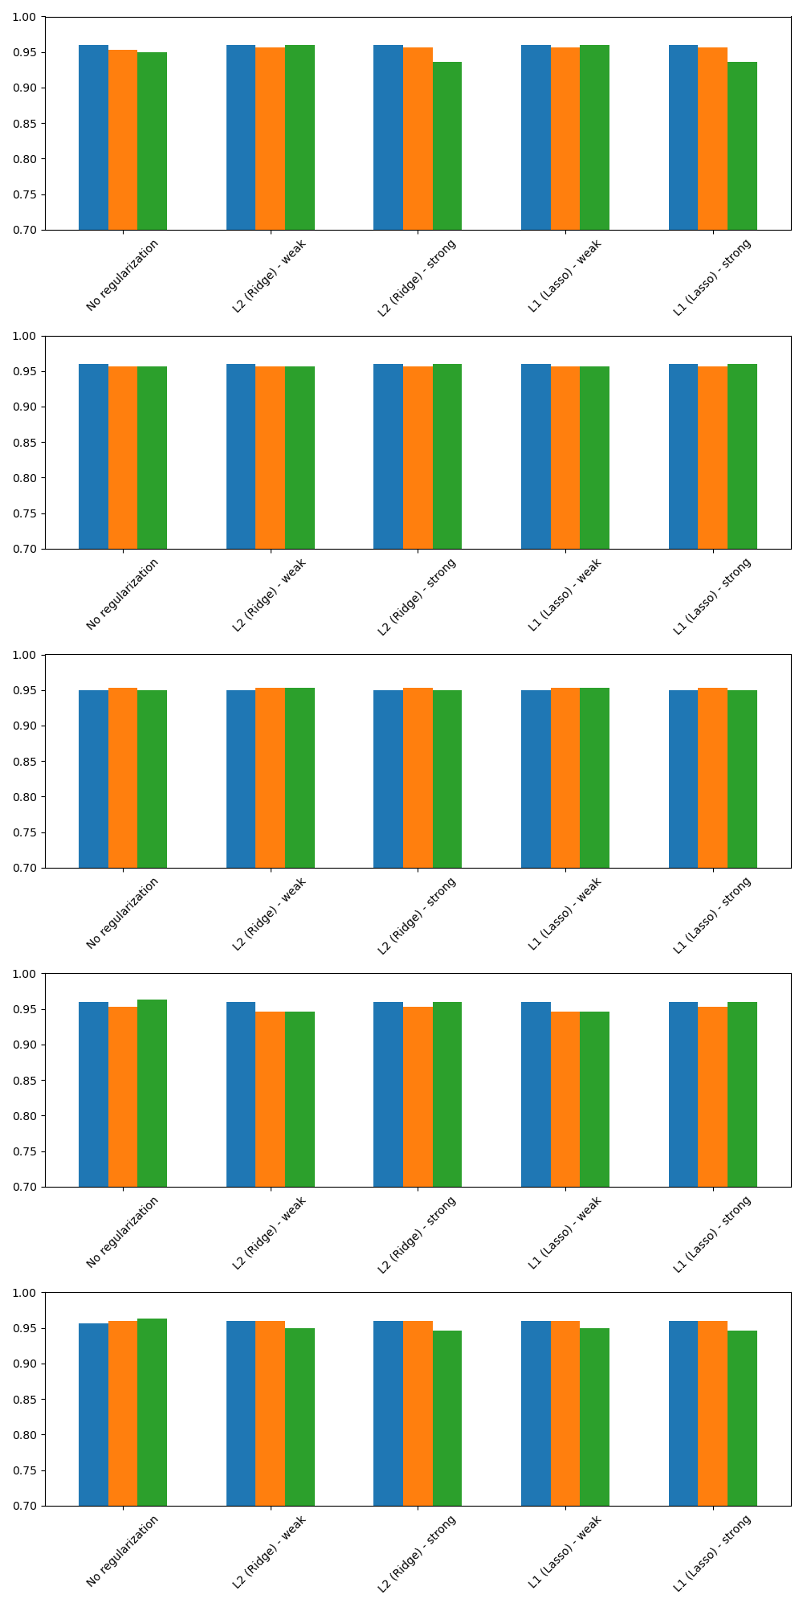
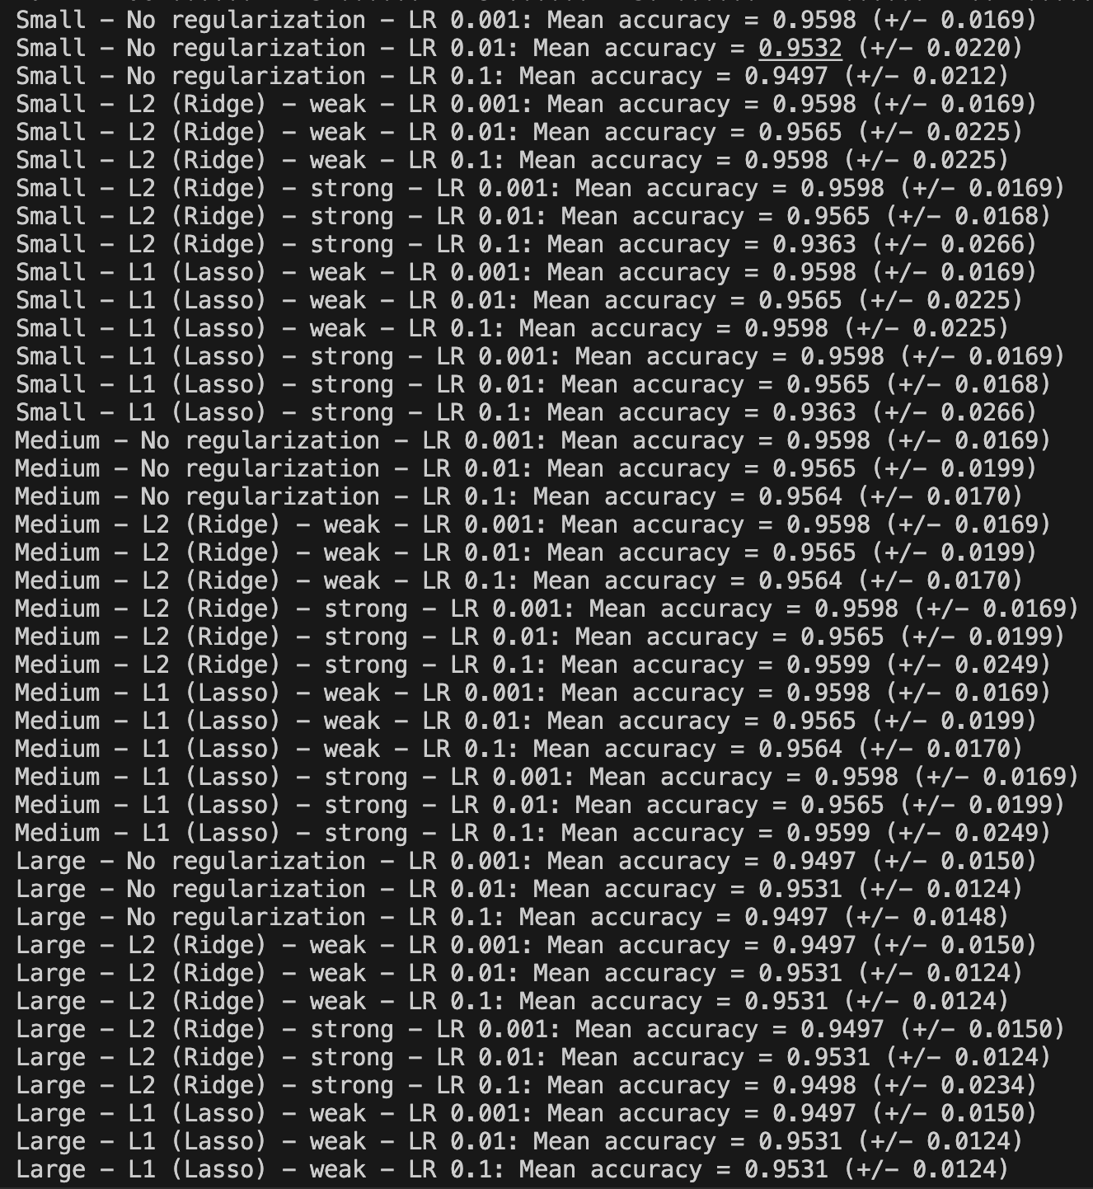
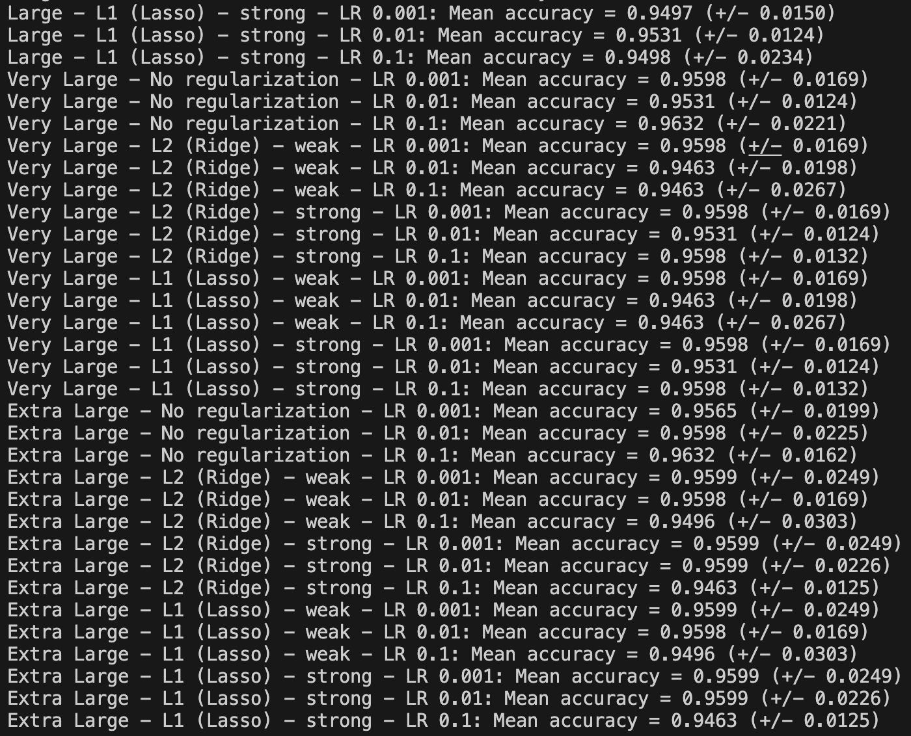
CS M148
UCLA
2024
Neural Networks
~90% accuracy - comparable to human specialists accuracy (theoretically)
The confusion matrix showed 7 false negatives compared to 0 false positives
Precision:
Class 0: 0.82
Class 1: 1.00
0.9426 AUC Score
Note: the differences between the 75 models were not significantly different
Findings
Smaller learning rates tends to matter more for smaller models
Regularization matters more for larger models

Slide 18
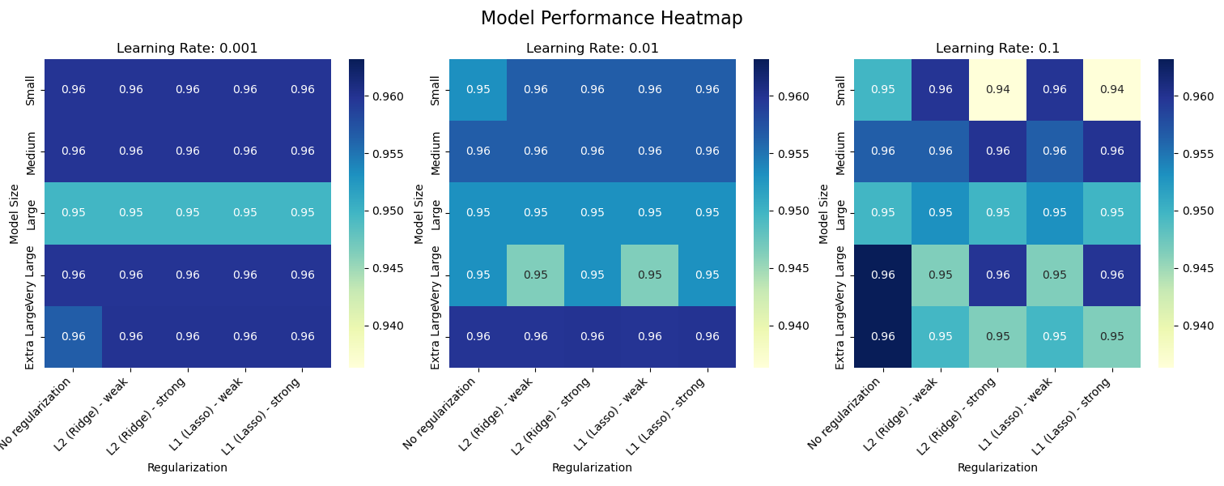
CS M148
UCLA
2024
Neural Networks: Another Quick Chart (based on training set accuracy)
Another finding
Strong regularization effected smaller models negatively when the learning rate was high
Whereas weak regularization outperformed no regularization (at high learning rates) for smaller models
Visually, larger learning rates are more chaotic

Slide 19

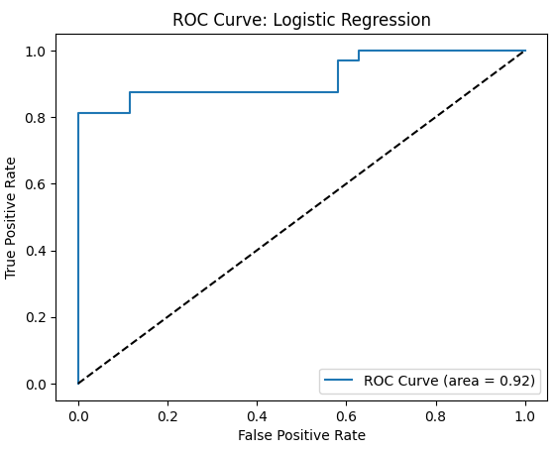
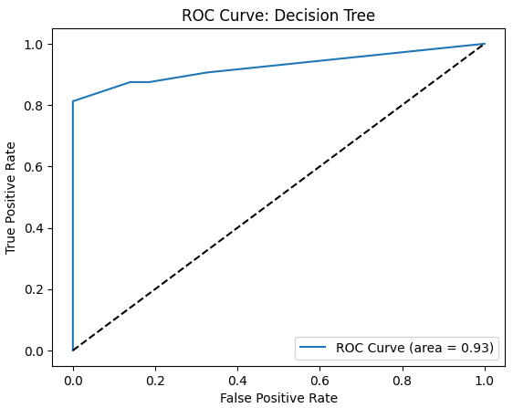
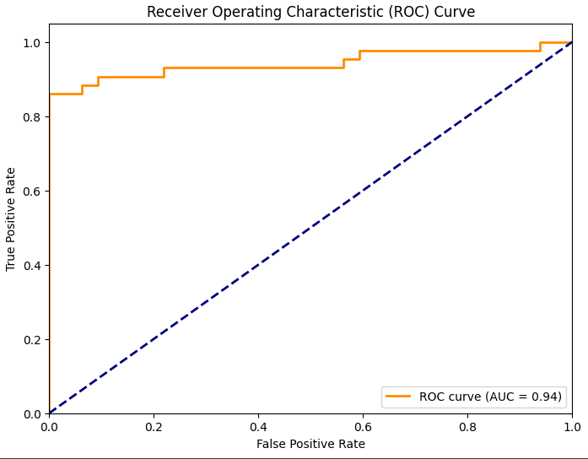
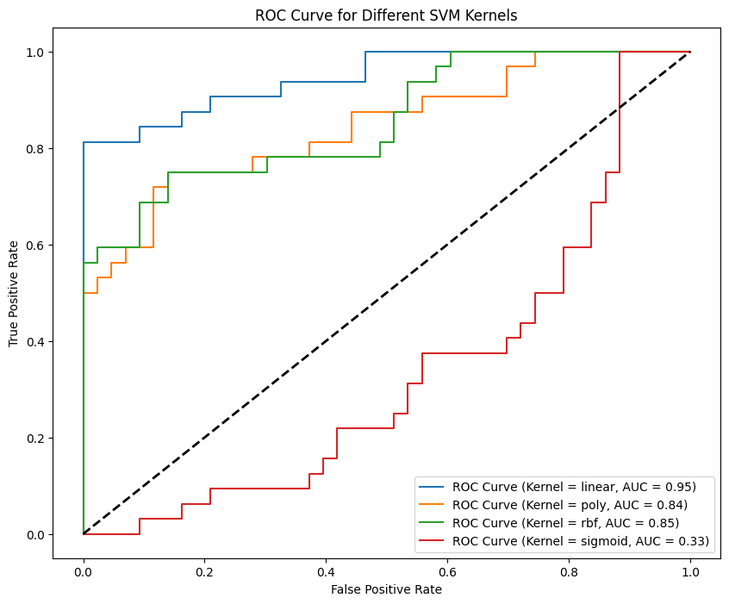
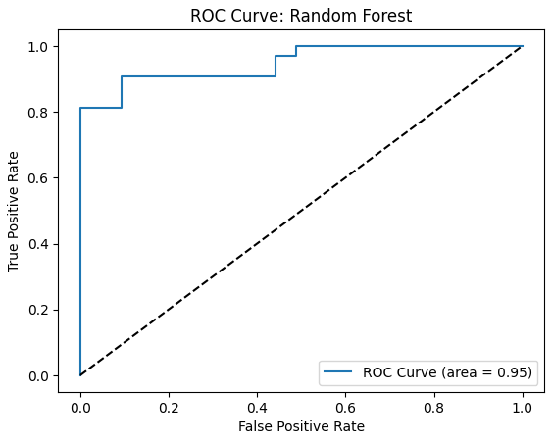
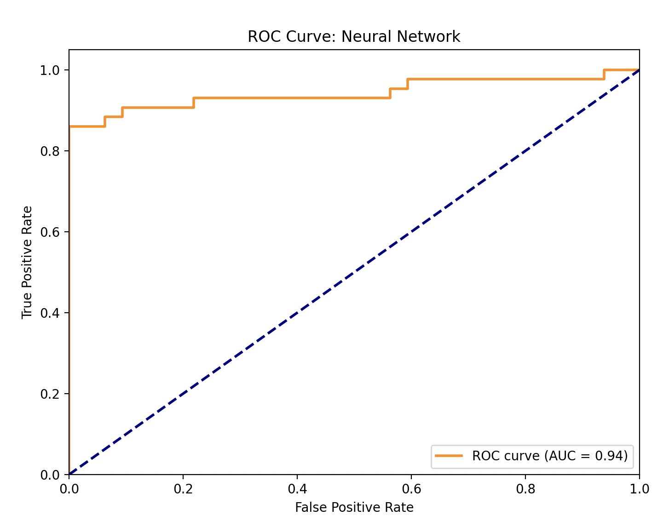
Visualizing
ROC CURVE PLOTS
CS M148
UCLA
2024

Slide 20

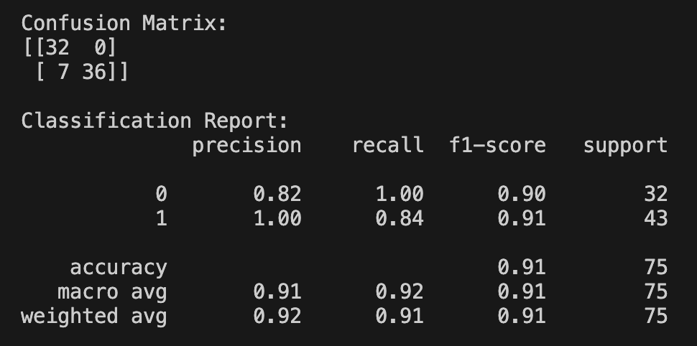
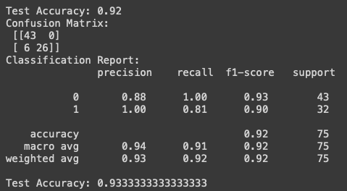
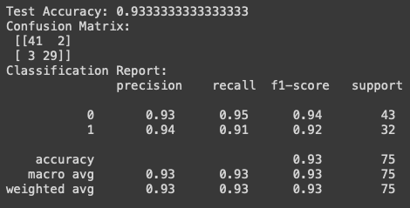
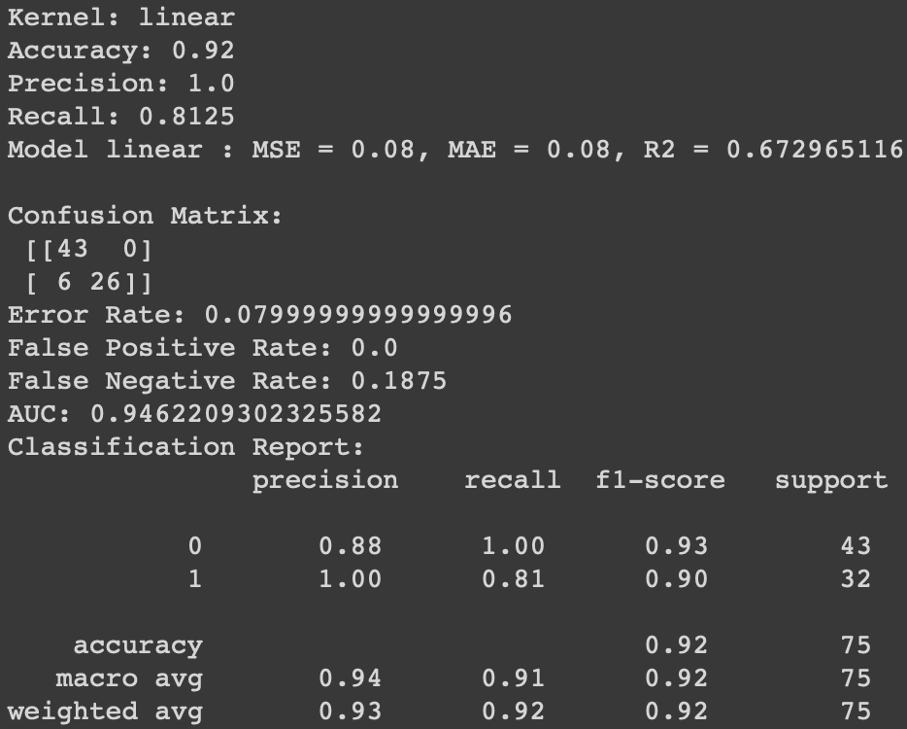
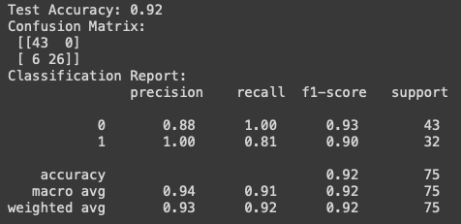
CS M148
UCLA
2024
Comparing
Confusion Matrices
Neural Network
Logistic Regression
Decision Tree
SVM (Linear & Non)
Random Forest

Slide 21
CS M148
UCLA
2024
Conclusion

Slide 22

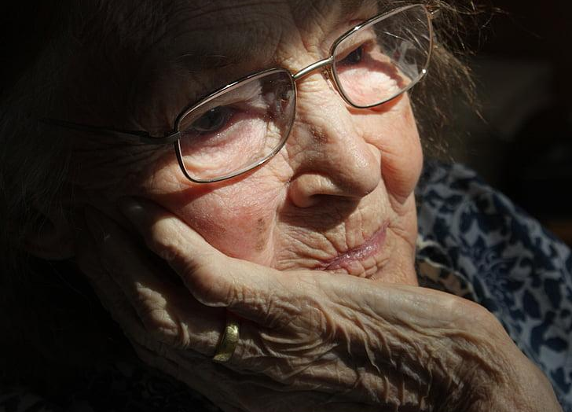
CS M148
UCLA
2024
Conclusion
Next Steps
Predictions via MRI Scans using CNN’s
More data/iterations

Slide 23
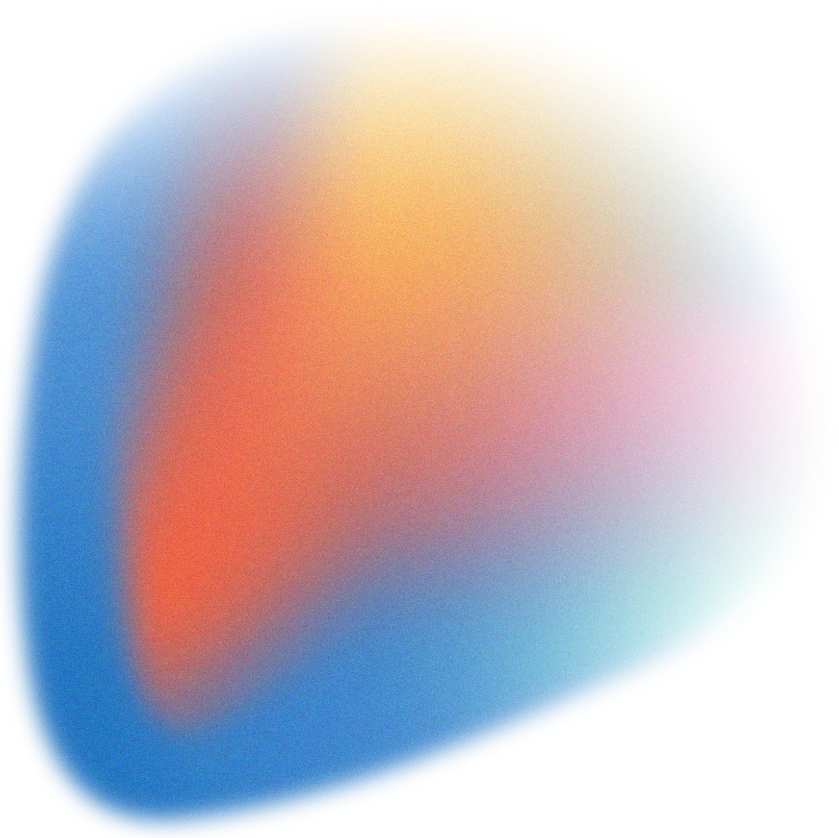
CS M148
UCLA
2024
References
Alzheimer Features by Baris Dincer
https://www.kaggle.com/datasets/brsdincer/alzheimer-features

Slide 24
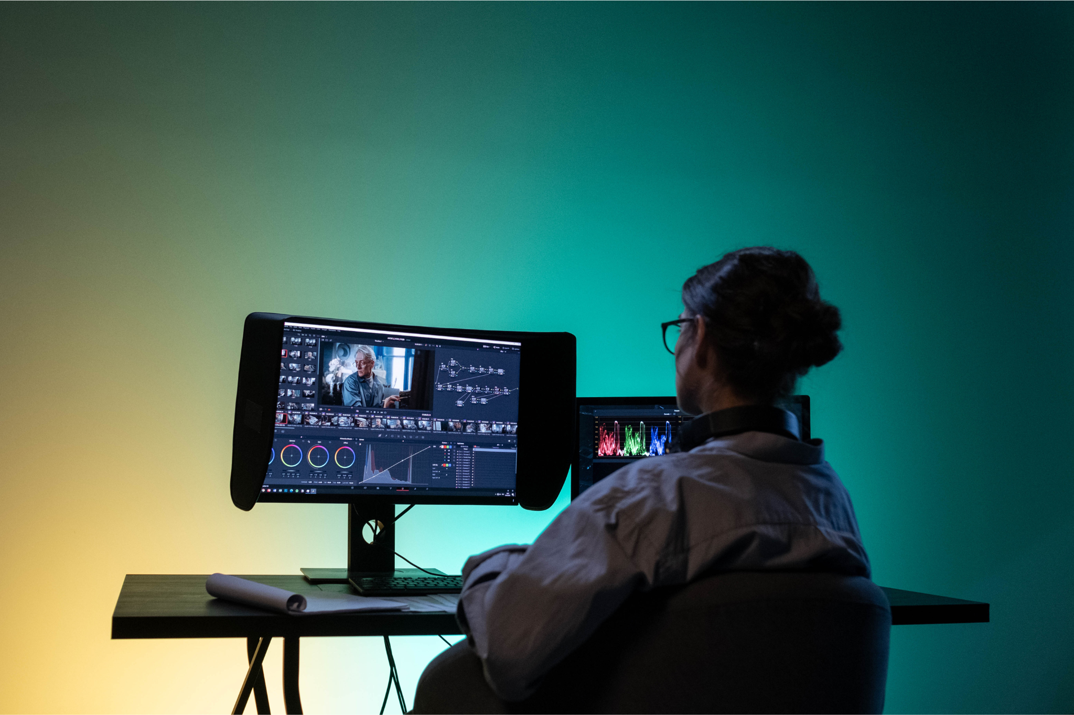
CS M148
UCLA
2024
Engineered by
Aneesh Bonthala | Arash Dewan | Jason Wan | Zeeshan Zaidi | William Escobar

